Slide 1


CITS1003 Introduction to Cybersecurity [9] Incidents exercises
Dr Zhi Zhang

Slide 2
Incident Modelling and Analysis
MS modelling tool
CALDERA

Slide 3
Modelling
What is incident modelling:
It is a structured approach to create a security model of a given system
It is used to assess various incidents and identify potential threats to an organization’s information systems

Slide 4
Modelling
What is incident modelling:
It is a structured approach to create a security model of a given system
A representative approach: STRIDE
Demo: MS Modelling Tool (based on STRIDE)

Slide 5
STRIDE
What is STRIDE?
It is a modelling approach used to categorize various incidents and identify all potential threats to an information system.
STRIDE stands for Spoofing, Tampering, Repudiation, Information disclosure, Denial of service, and Elevation of privilege.

Slide 6
STRIDE
Category | Description
Spoofing | An attacker impersonates a targeted user to gain unauthorized access to a system.
Tampering | An attacker modifies data or code to change the behavior of a software/system.
Repudiation | An attacker denies their actions or the actions of others on the system.

Slide 7
STRIDE
Category | Description
Spoofing | An attacker impersonates a targeted user to gain unauthorized access to a system.
Tampering | An attacker modifies data or code to change the behavior of a software/system.
Repudiation | An attacker denies their actions or the actions of others on the system.
Information Disclosure | An attacker accesses unauthorized sensitive information.
Denial of Service | An attacker prevents legitimate users from accessing a target system or performing actions on the system.
Elevation of Privilege | An attacker gains higher-privilege access to a target system than they are authorized to have.

Slide 8
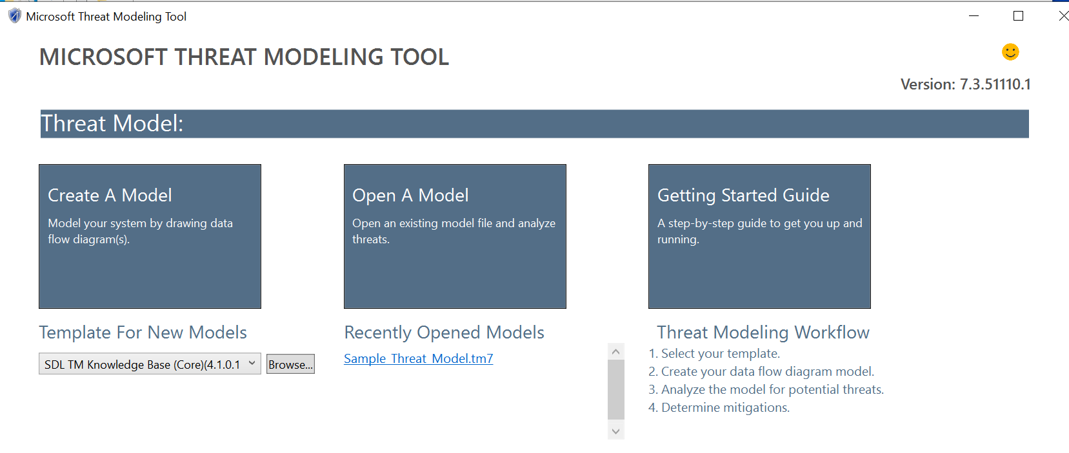
MS Modelling Tool
MS modelling tool only supports windows OS
https://docs.microsoft.com/en-gb/azure/security/develop/threat-modeling-tool-getting-started

Slide 9
Demo
Given this scenario
Alice opens a browser to login to a web server via her own credentials.
The web server will authenticate Alice by validating her username and password via its SQL database.
Draw a diagram using MS modelling tool

Slide 10
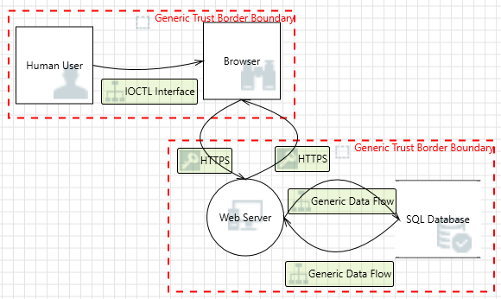
Demo

Slide 11
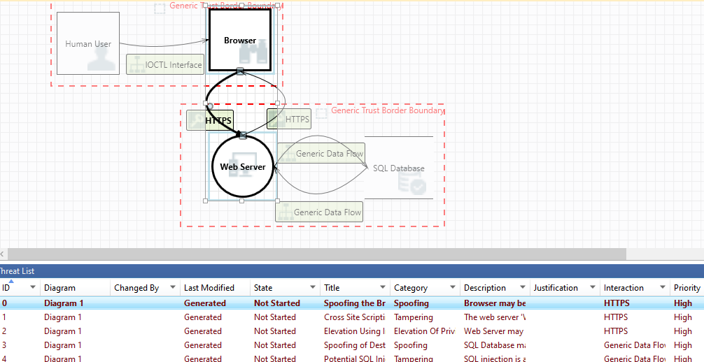
Demo

Slide 12
Demo
How to generate this diagram

Slide 13
Demo
How to generate a full report

Slide 14
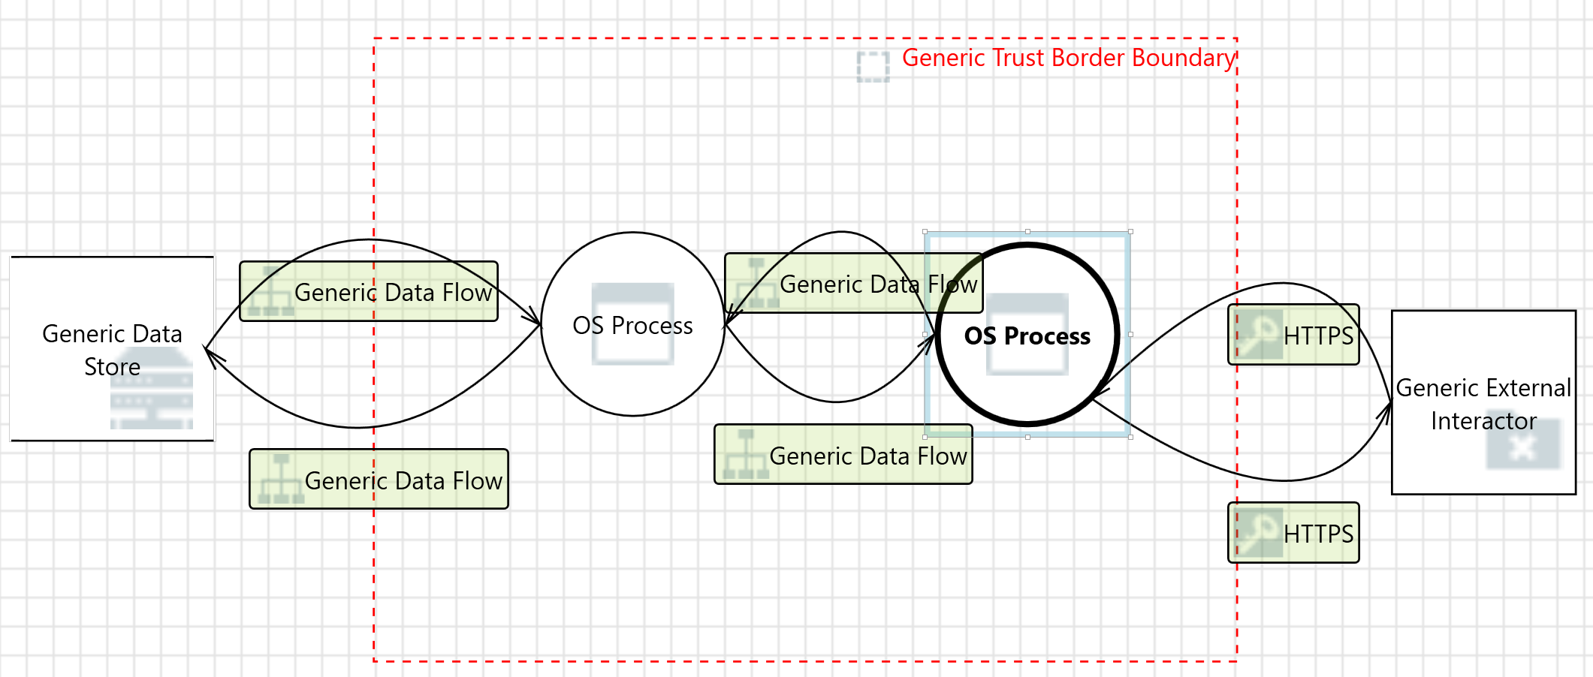
Exercise
Given this diagram

Slide 15
Exercise
Given this diagram

Slide 16
Exercise
Given this diagram
web application
browser

Slide 17
Exercise
Given this diagram
local SQL database
web application
browser

Slide 18
Exercise
Given this diagram
SQL backup database
local SQL database
web application
browser

Slide 19
Exercise
A possible scenario:
Alice opens a browser to login to a web server via her own credentials.
The web server will validate Alice by checking if her username and password are stored in its local SQL database.
When Alice updates her personal information, the local SQL database interacts with the SQL backup database to synchronize the updates.

Slide 20
Modelling
If there are multiple threats with the same severity in a threat model, which one should be addressed first?

Slide 21
Modelling
If there are multiple threats with the same severity in a threat model, which one should be addressed first?
An example answer:
It is important to prioritize the threats with the same-level severity based on some critical factors
e.g., probability of success, and resource costs

Slide 22
CALDERA
cyber range simulates real-world network environment that can be used to replicate real-world cyber scenarios.
red team is a group of security professionals who simulate cyber attacks and thus identify weaknesses that can be exploited by real attackers
blue team is a group of security professionals who respond to the simulated attacks and test their incident responses.

Slide 23
CALDERA
cyber range simulates real-world network environment that can be used to replicate real-world cyber scenarios.
red team is a group of security professionals who simulate cyber attacks and thus identify weaknesses that can be exploited by real attackers
blue team is a group of security professionals who respond to the simulated attacks and test their incident responses.
CALDERA provides such a cyber-range environment where red team and blue team are involved.

Slide 24
CALDERA
Installation
Open a Linux VM
Run the following commands:
sudo apt install python3-pip
git clone https://github.com/mitre/caldera.git --recursive
cd caldera
pip3 install -r requirements.txt
python3 server.py --insecure

Slide 25
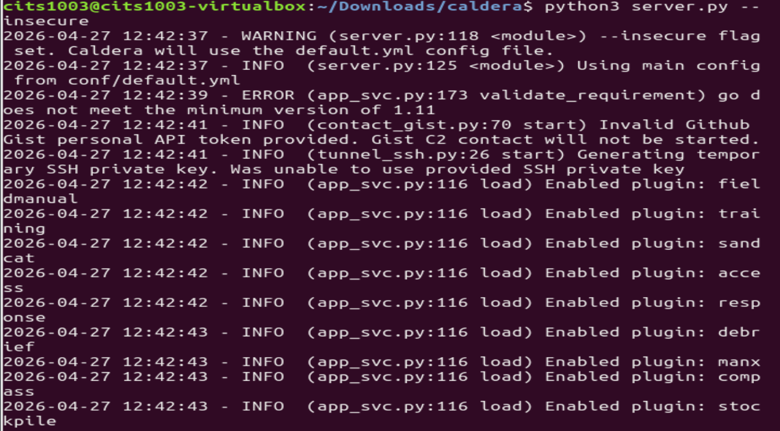
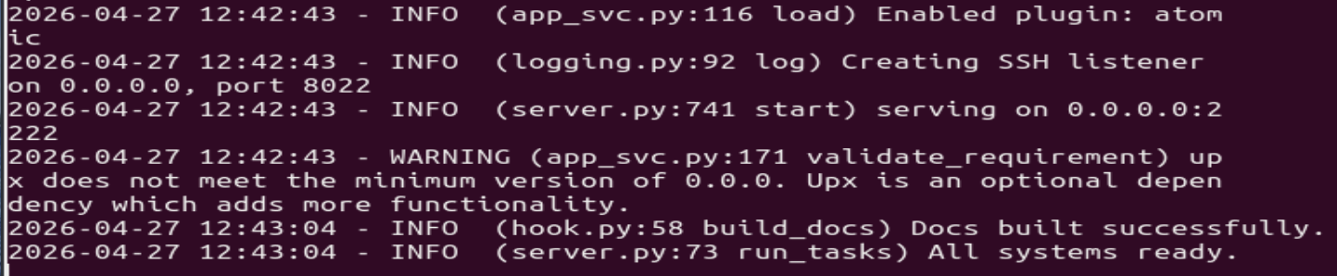

Slide 26
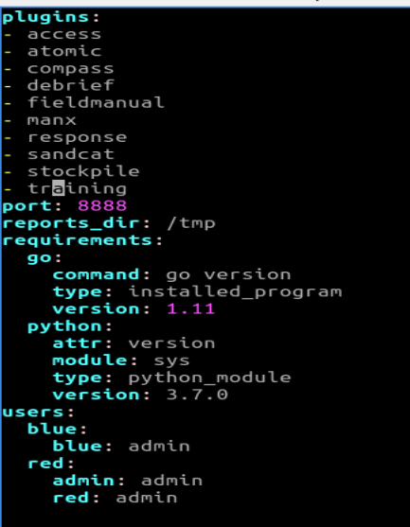
CALDERA
Login
In caldera/conf/default.vml,

Slide 27
CALDERA
Login
Open a browser
Enter the following URL in the address bar
http://localhost:8888
username: red
password: admin

Slide 28
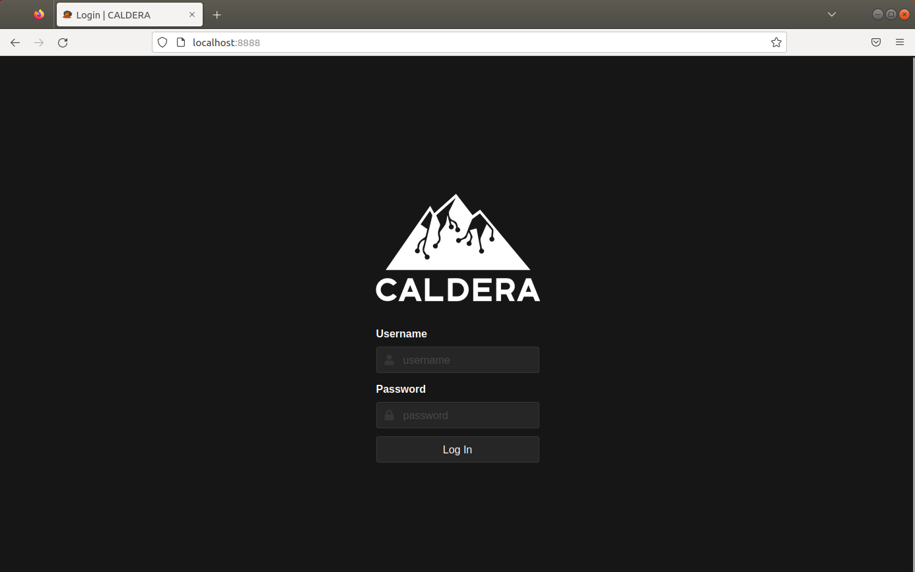
CALDERA

Slide 29
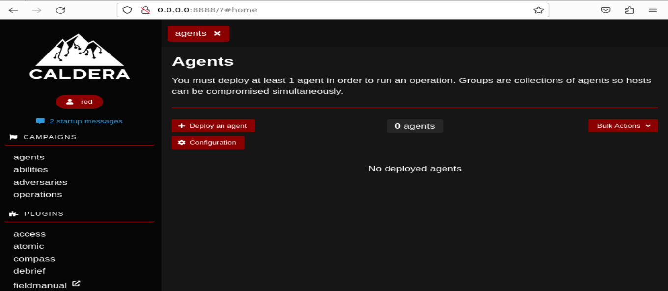
CALDERA

Slide 30
CALDERA
Adversary is a profile of instructions that describe various TTPs (Tactics, Techniques and Procedures) to be performed on a targeted system. An adversary profile can be used to simulate an attack automatically.

Slide 31
CALDERA
Tactic: high-level attack goal that attackers aim to achieve.
e.g., gaining unauthorized access.
Technique: specific method used by attackers to achieve a tactic.
e.g., exploiting vulnerabilities.
Procedure: step-by-step process followed by attackers when executing a technique.
e.g., specific Linux commands in each step.

Slide 32
CALDERA
Adversary is a profile of instructions that describe various TTPs to be performed on a targeted system. An adversary profile can be used to simulate an attack automatically.
Agent works as a spy program that is installed on the targeted system and responsible for executing TTPs specified in the adversary profile.

Slide 33
CALDERA
Adversary is a profile of instructions that describe various TTPs to be performed on a targeted system. An adversary profile can be used to simulate an attack automatically.
Agent works as a spy program that is installed on the targeted system and responsible for executing TTPs specified in the adversary profile.
Ability is a specific implementation of a tactic/technique including what commands to run and what OS the commands can run on.
e.g., display information about running processes by running ``ps –aux” in Linux

Slide 34
CALDERA
Adversary is a profile of instructions that describe various TTPs (tactics, techniques and procedures) to be performed on a targeted system. An adversary profile can be used to simulate an attack or evaluate the effectiveness of a security defense.
Agent works as a spy program that is installed on the targeted system and responsible for executing TTPs specified in the adversary profile.
Ability is a specific implementation of a tactic/technique including what commands to run and what OS the commands can run on.
Operation is to create an adversary profile and execute the profile via agent.

Slide 36
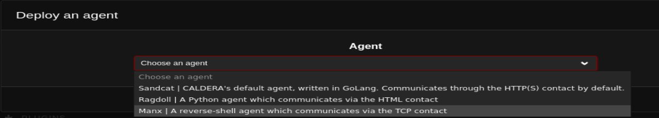

Slide 37
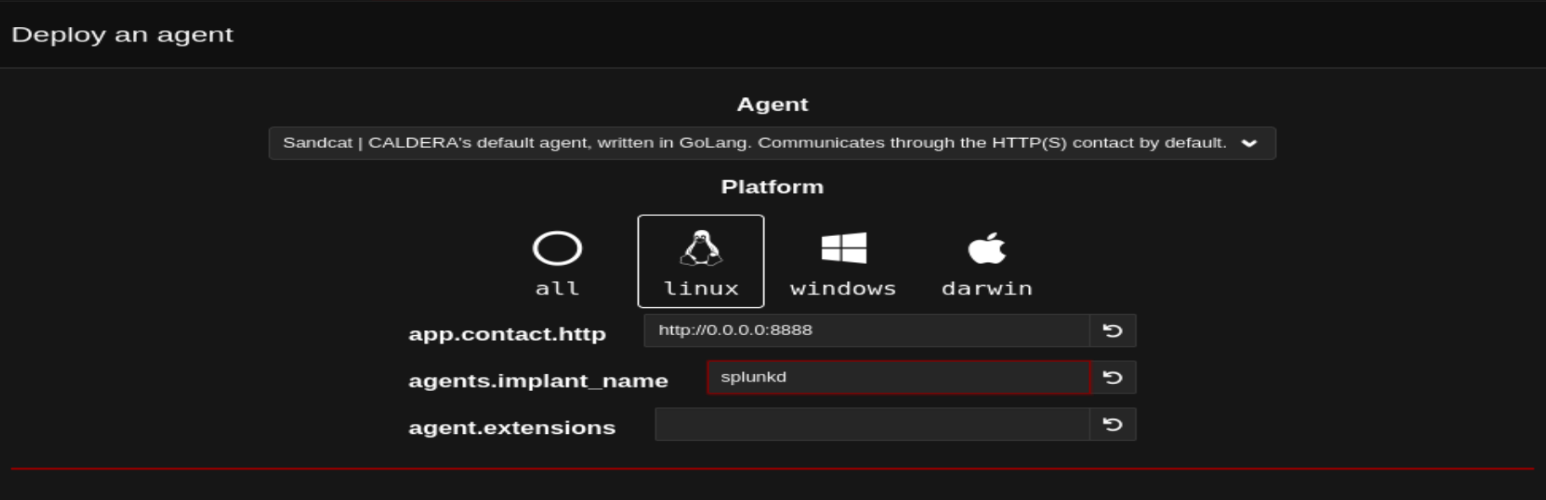
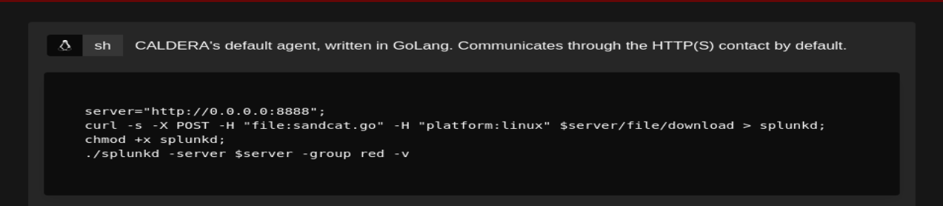

Slide 38

chmod +x agent.sh

Slide 39
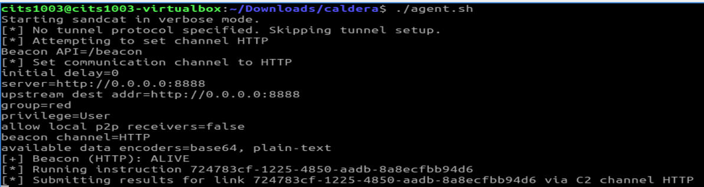

Slide 40
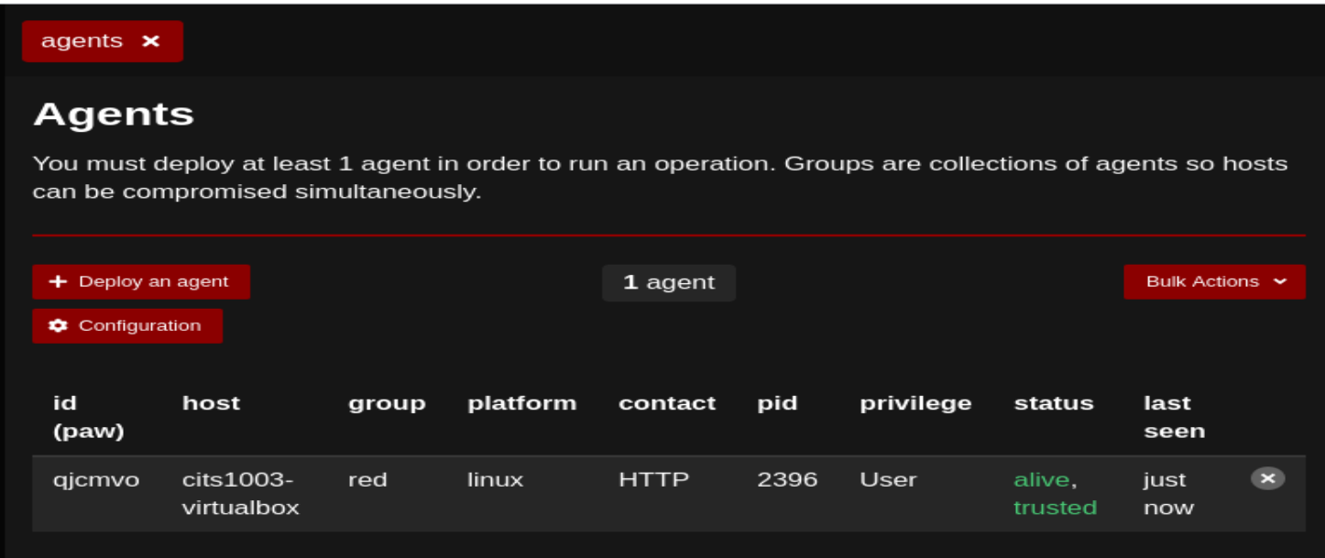

Slide 41
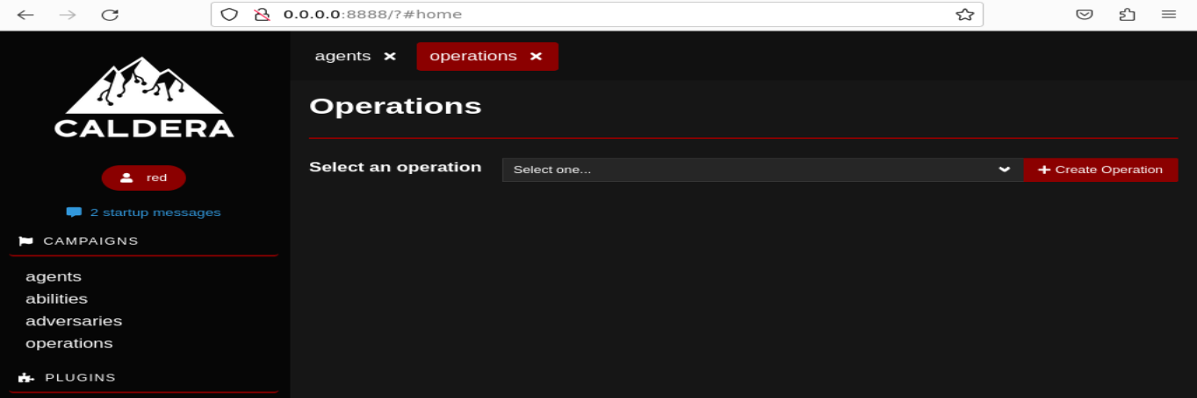

Slide 42
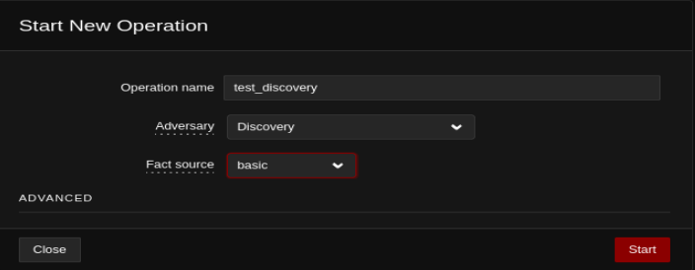

Slide 43
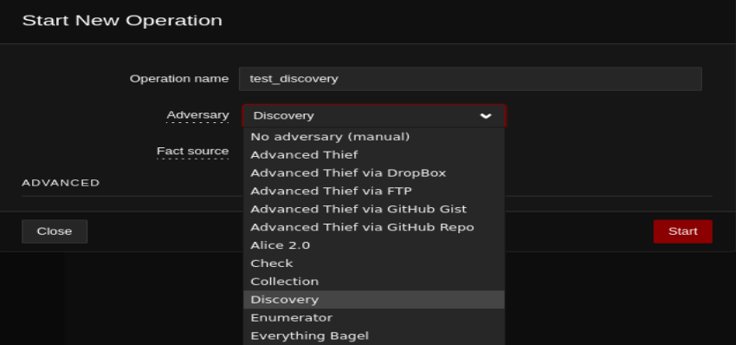
https://caldera.readthedocs.io/en/latest/plugins/stockpile/Exfiltration-How-Tos.html

Slide 44
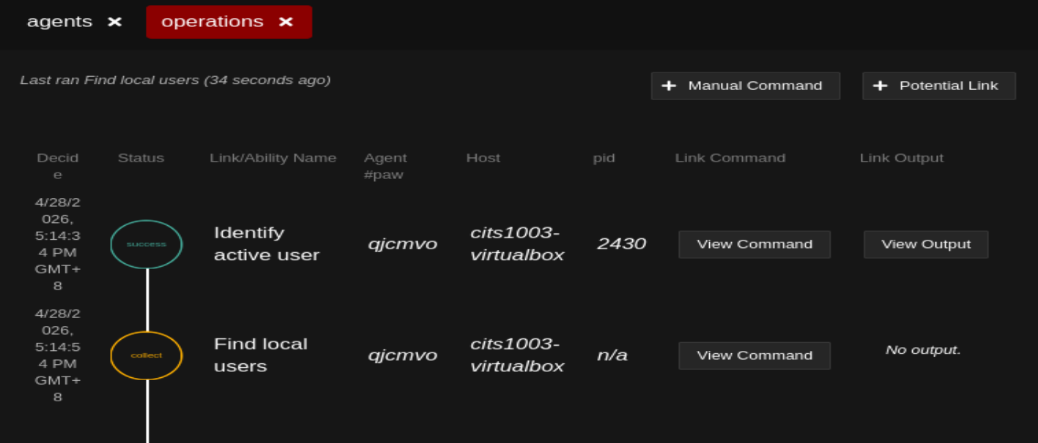

Slide 45
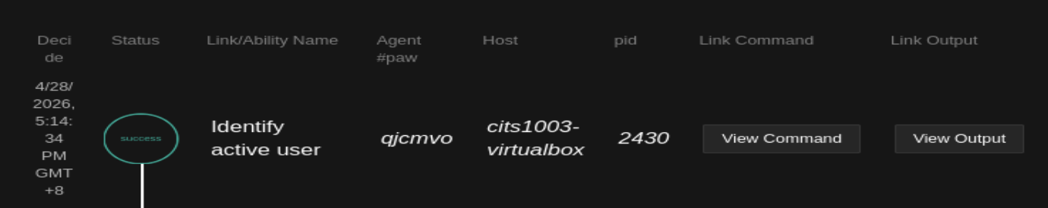
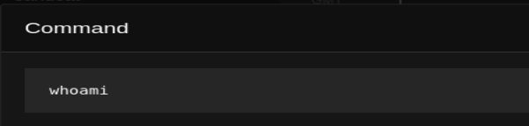
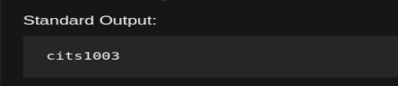

Slide 46
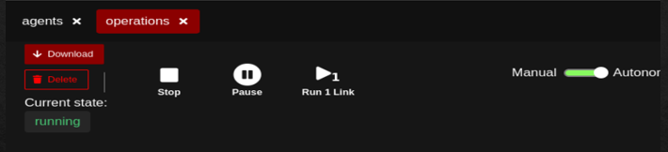
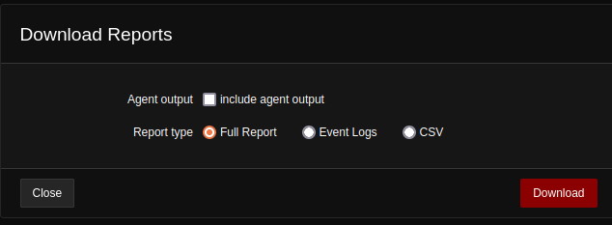

Slide 47
CALDERA
Demo

